Slide 1

Tel Aviv University
Universal Algorithm to Predict Cleavage Planes in Single Crystals
Student: Uriel Vaknin
Supervisors: Dr. Sëmen Gorfman, Prof. Dov Sherman
Materials Science and Engineering Department
School of Mechanical Engineering
Notes:
Hi everyone,
My name is Uriel Vaknin, and I’m excited to be here today for my seminar talk.
The subject of this talk will be Universal Algorithm to Predict Cleavage Planes in Single Crystals.
The supervisors of this thesis talk are Dr. Sëmen Gorfman, Prof. Dov Sherman,
And it was carried out in the Materials Science and Engineering Department and the School of Mechanical Engineering

Slide 2
Outline
Introduction
Aim of Work
Model
Results
Conclusions
Notes:
This is the outline for this talk and we will go over the Introduction, the Aim of this Work, describing our Model,
And we’ll finish with the Results and Conclusions parts.

Slide 3
Outline
Introduction
Aim of Work
Model
Results
Conclusions
Notes:
So let’s start with the Introduction

Slide 4
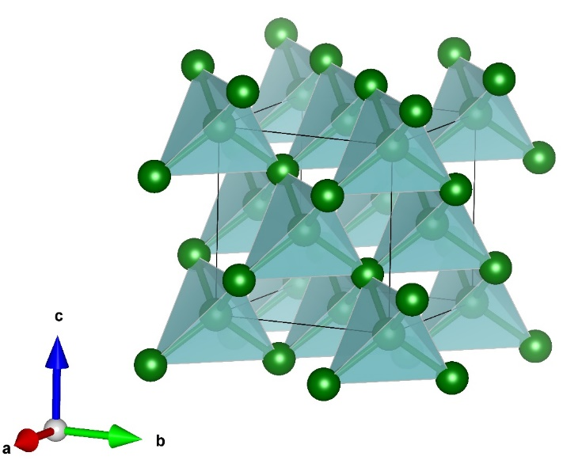
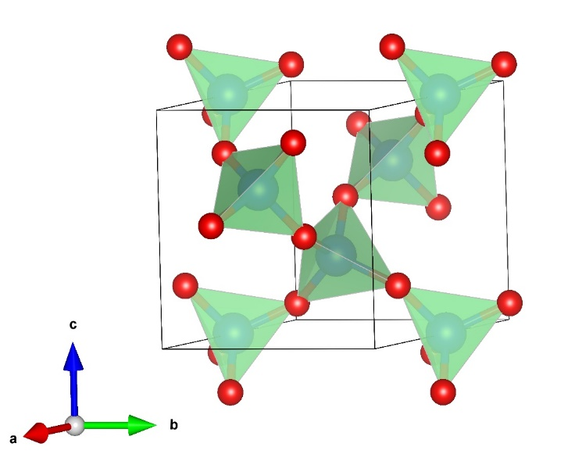
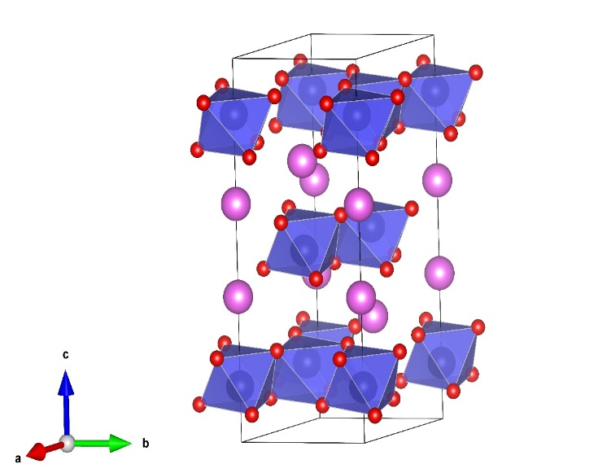
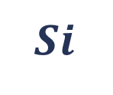
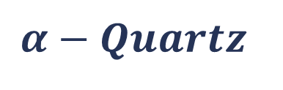
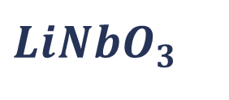
What is a crystal?
A long range order periodic arrangement of atoms
single crystal
A continuous crystal lattice with no grain boundaries
$$Si$$
$$α−Quartz$$
$$LiNbO_{3}$$
Notes:
What is a Crystal?
It’s a long range order periodic arrangement of atoms,
And a Single Crystal is a continuous lattice with no grain boundaries.
In this work we focused on three single crystals – Silicon, alpha-Quartz, and Lithium-niobate.

Slide 5
Cleavage
The tendency of crystal to break along specific lattice planes
Depends on the arrangement of atoms and chemical bonds strength
Free surface energy is the work required to separate crystal into two parts
There is a close relation between cleavage energy and free surface energy
For the simple case: cleavage energy = 2 x free surface energy
Notes:
We also need to talk about Cleavage –
Which is the tendency of a crystal to break along specific lattice planes, of course it depends on the arrangement of atoms and chemical bonds.
Free surface energy is the work required to separate a crystal into two parts.
Cleavage energy and Free surface energy are closely related, and in the simple case the cleavage energy is twice the free surface energy.
For more complex cases it would be the sum of the free surface energies of the upper and the lower planes.

Slide 6
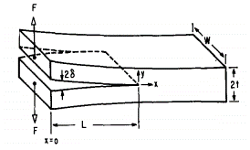
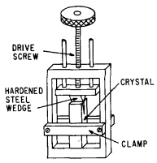
Experimental setup for surface energies measurements
Double cantilever beam specimen. Wedge is moving at constant speed
F – applied force, W – width, δ - deflection
L – crack’s length, 2t – thickness
The crystals are initially cracked along their lengths
1. Gilman, J. J. Direct measurements of the surface energies of crystals. J. Appl. Phys. 31, 2208–2218 (1960).
Notes:
If we wish to describe how we create cleavage experimentally, we can go back to the famous experiment of Gilman, back than in the 60s.
The experimental setup included a double cantilever beam specimen, and a wedge moving at constant speed. The different parameters are described in the plot.

Slide 7
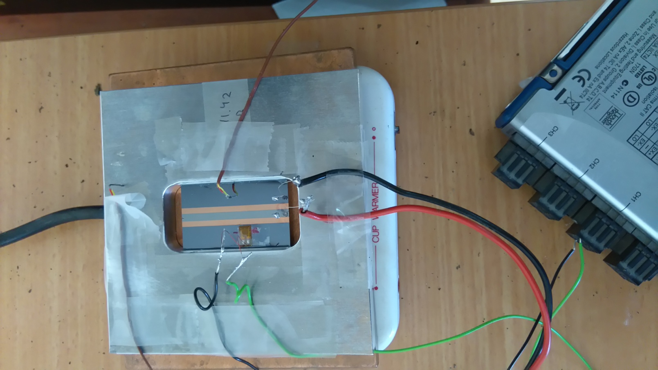
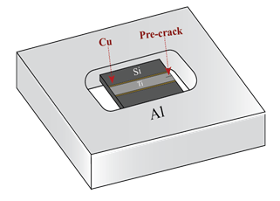
Experimental - CTEM method
Coefficients of Thermal Expansion Mismatch (CTEM) Method
Aluminum loading frame with rectangular hole
Specimen located inside the hole
Precracked by thermal shock
Specimen glued by epoxy resin
Heating on top of electrical heating stage
In-situ strain and temperature measurement
2. Hirsh, Y., Gorfman, S. & Sherman, D. Cleavage and surface energies of LiNbO3. Acta Mater. 193, 338–349 (2020)
Notes:
Of course there are much modern techniques to create cleavage, one of them is the CTEM method, Coefficients of Thermal Expansion Mismatch.
This is a patent of Prof. Dov Sherman who use this technique in his research lab. There is an aluminum loading frame with a rectangular hole, where the specimen is located. The sample is Precracked by thermal shock, and then glued to the loading frame by an epoxy resin. Then it is heated on top of an electrical heating stage, and due to Thermal Coefficient Mismatch there is an exerted stress on the sample and the crack is propagating.

Slide 8
Outline
Introduction
Aim of Work
Model
Results
Conclusions
Notes:
Aim of Work

Slide 9

Developing an algorithm for automatic inspection of crystal structures
Prediction of the likely cleavage planes of a crystal structure
Substituting the manual structure inspection
INPUT – CIF file
Contains all the relevant information about the crystal structure
OUTPUT –
Cleavage planes list
Identifying the minimum values as cleavage planes
Notes:
The aim of our work was to develop an algorithm for automatic inspection of crystal structures, where we wish to predict its likely cleavage planes.
The purpose of this algorithm was to substitute a manual structure inspection (VESTA??)

Slide 10

MOTIVATION
Notes:
So why do we really need it, what is our Motivation?
There are no simple or fast techniques today to predict cleavage. The experimental way takes relatively a lot of time, starting from a couple of days to check one plane, and way more than that if we wish to check a lot of planes.
The only theoretical way to predict cleavage is to use DFT calculations, which are very complex and also consume a lot of time. This is by the way how I would look like if I had to execute some DFT calculations.

Slide 11

MOTIVATION
Notes:
Our algorithm offers much more intuitive, simple and fast way to predict cleavage. And you can see that the smile came back to myself.

Slide 12
Outline
Introduction
Aim of Work
Model
Results
Conclusions

Slide 13
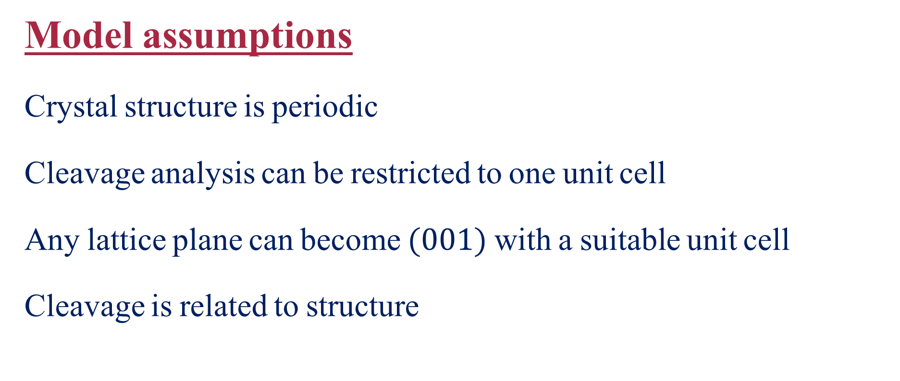
Model assumptions
Crystal structure is periodic
Cleavage analysis can be restricted to one unit cell
Any lattice plane can become $(001)$ with a suitable unit cell
Cleavage is related to structure
Notes:
Our model assumptions are that cleavage structure is periodic, therefore we can restrict our analysis to one unit cell only.
Any lattice plane can become (001) plane, using a suitable unit cell, and that cleavage is related to structure.
The first two assumptions are pretty much straight-forward, so let’s talk about the third assumption ---

Slide 14
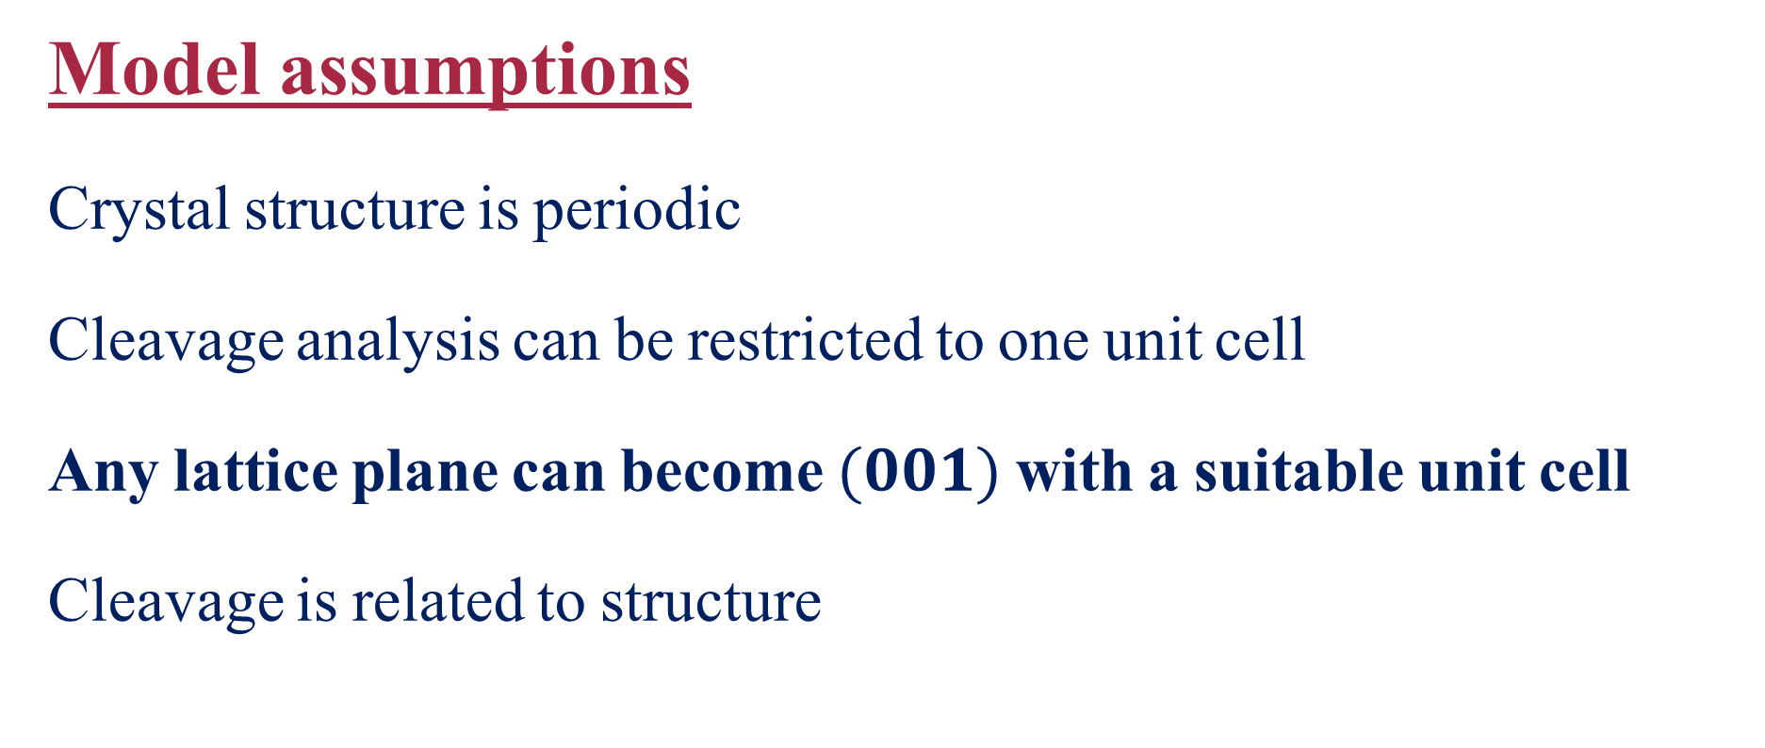
Model assumptions
Crystal structure is periodic
Cleavage analysis can be restricted to one unit cell
Any lattice plane can become $(001)$ with a suitable unit cell
Cleavage is related to structure
Notes:
Any lattice plane can become $(001)$ plane using a suitable unit cell

Slide 15
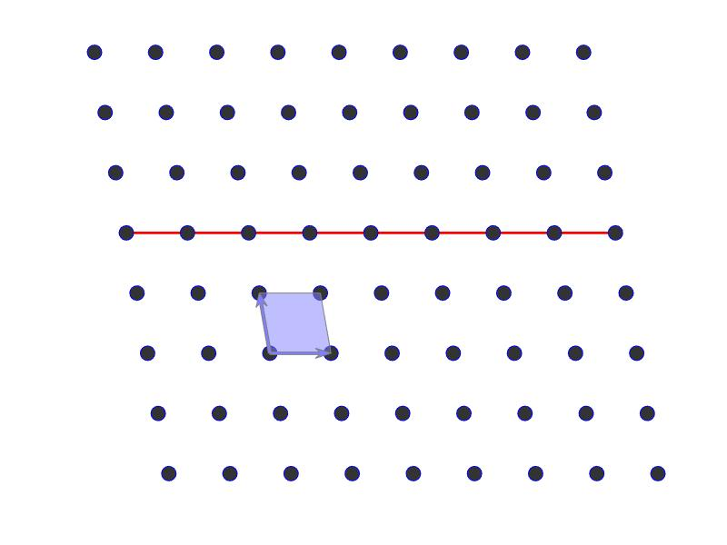
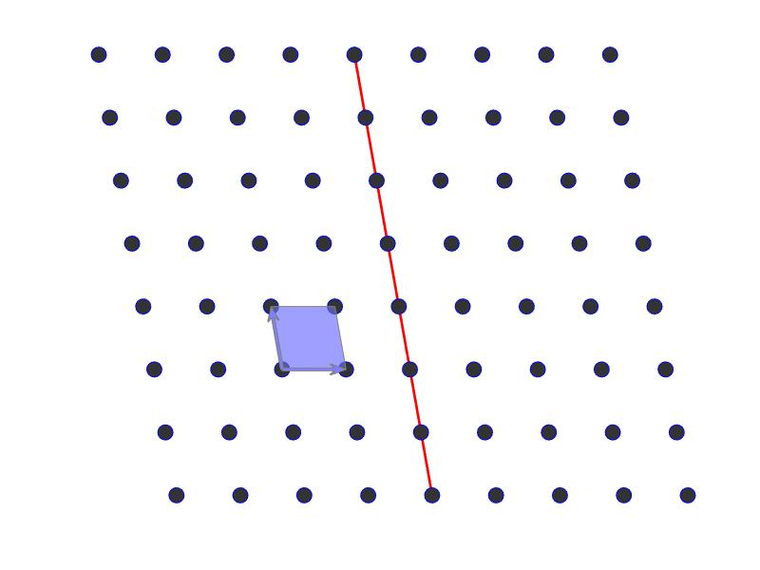
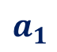
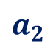

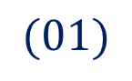
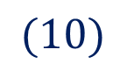
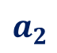
2-D case: “Any lattice plane can become $(01)$ plane”
$$(01)$$
$$(10)$$
$$a_{2}$$
$$a_{2}$$
$$a_{1}$$
$$a_{1}$$
Notes:
In case of 2D lattice this assumption change a bit claiming that “Any lattice plane can become $(01)$ plane”.
On the left we can see the basis vector a1 a2, and plane (01) in respect to these vectors. On the right we have plane (10) and the question is how can we change the choice of the basis vectors so that plane become (01). The answer in this case is pretty simple ---

Slide 16
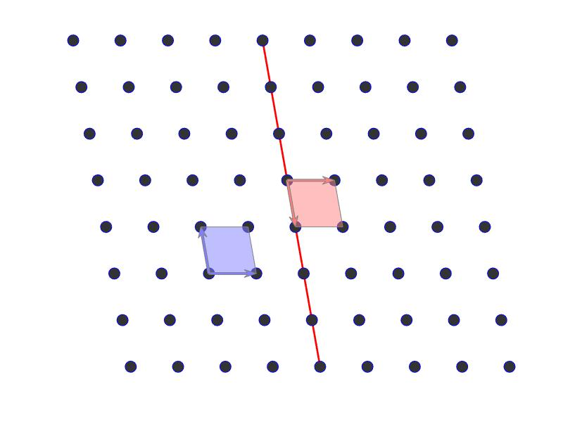

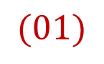
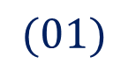
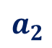
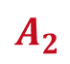

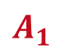
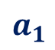
2-D case: “Any lattice plane can become $(01)$ plane”
$$(01)$$
$$(01)$$
$$A_{2}$$
$$a_{2}$$
$$a_{2}$$
$$A_{1}$$
$$a_{1}$$
$$a_{1}$$
Notes:
We just need to switch between a1 and a2 as you can see in the red basis vectors.

Slide 17
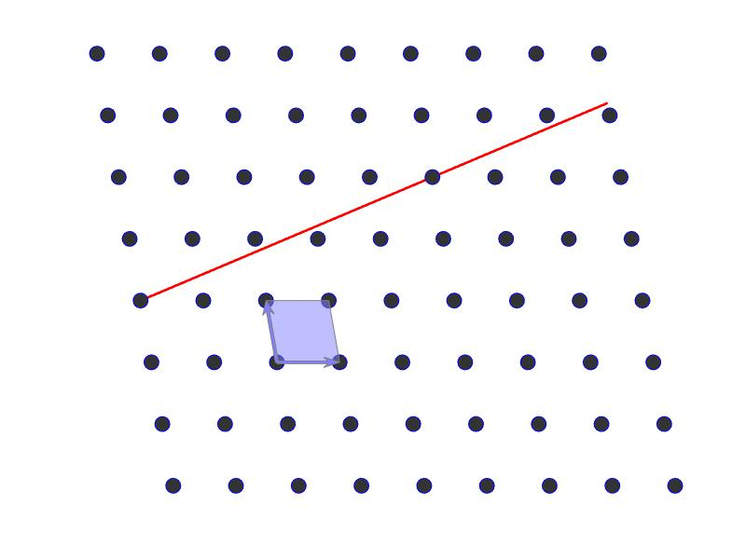
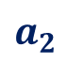
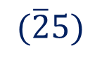
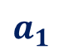
2-D case: “Any lattice plane can become $(01)$ plane”
$$(01)$$
$$(\overline{2}5)$$
$$a_{2}$$
$$a_{2}$$
$$a_{1}$$
$$a_{1}$$
Notes:
But what if we have a plane such as (-25) ?
The concept is that we must chose a1 so it’s laying on the plane and a2 just need to preserve the unit cell rules.

Slide 18
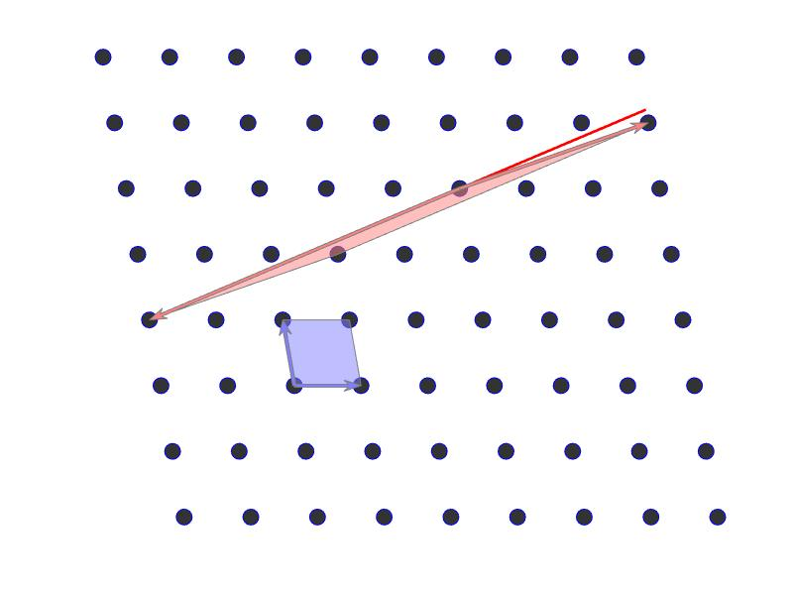
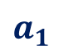
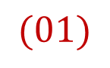
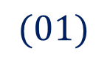
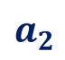
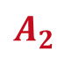
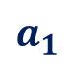
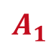
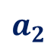
2-D case: “Any lattice plane can become $(01)$ plane”
$$(01)$$
$$A_{2}$$
$$(01)$$
$$A_{1}$$
$$a_{2}$$
$$a_{2}$$
$$a_{1}$$
$$a_{1}$$
Notes:
In this case these basis vectors in red assures that this plane is now (01) plane.

Slide 19
Model assumptions
Crystal structure is periodic
Cleavage analysis can be restricted to one unit cell
Any lattice plane can become $(001)$ with a suitable unit cell
Cleavage is related to structure
Notes:
The fourth assumption also requires some explanations ---

Slide 20
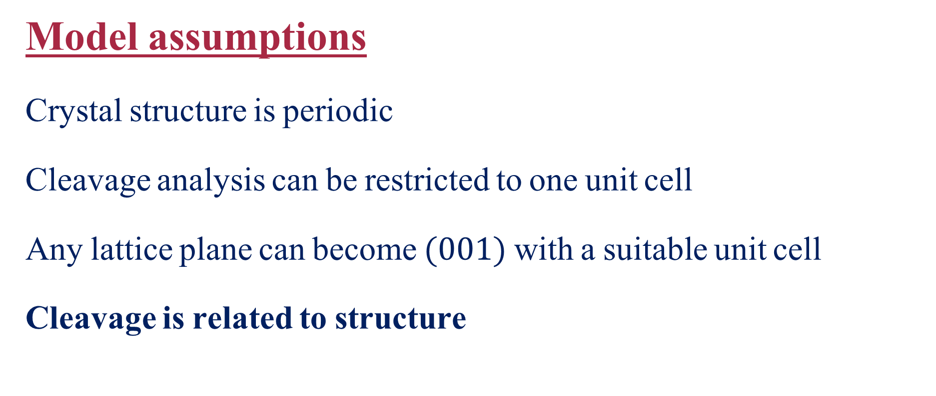
Model assumptions
Crystal structure is periodic
Cleavage analysis can be restricted to one unit cell
Any lattice plane can become $(001)$ with a suitable unit cell
Cleavage is related to structure
Notes:
Claiming that - Cleavage is related to structure

Slide 21
Cleavage is related to structure
Average atomic density
Tendency to cleave
Notes:
We claim that as the average atomic density goes down --- CLICK
The tendency to cleave goes up --- CLICK

Slide 22
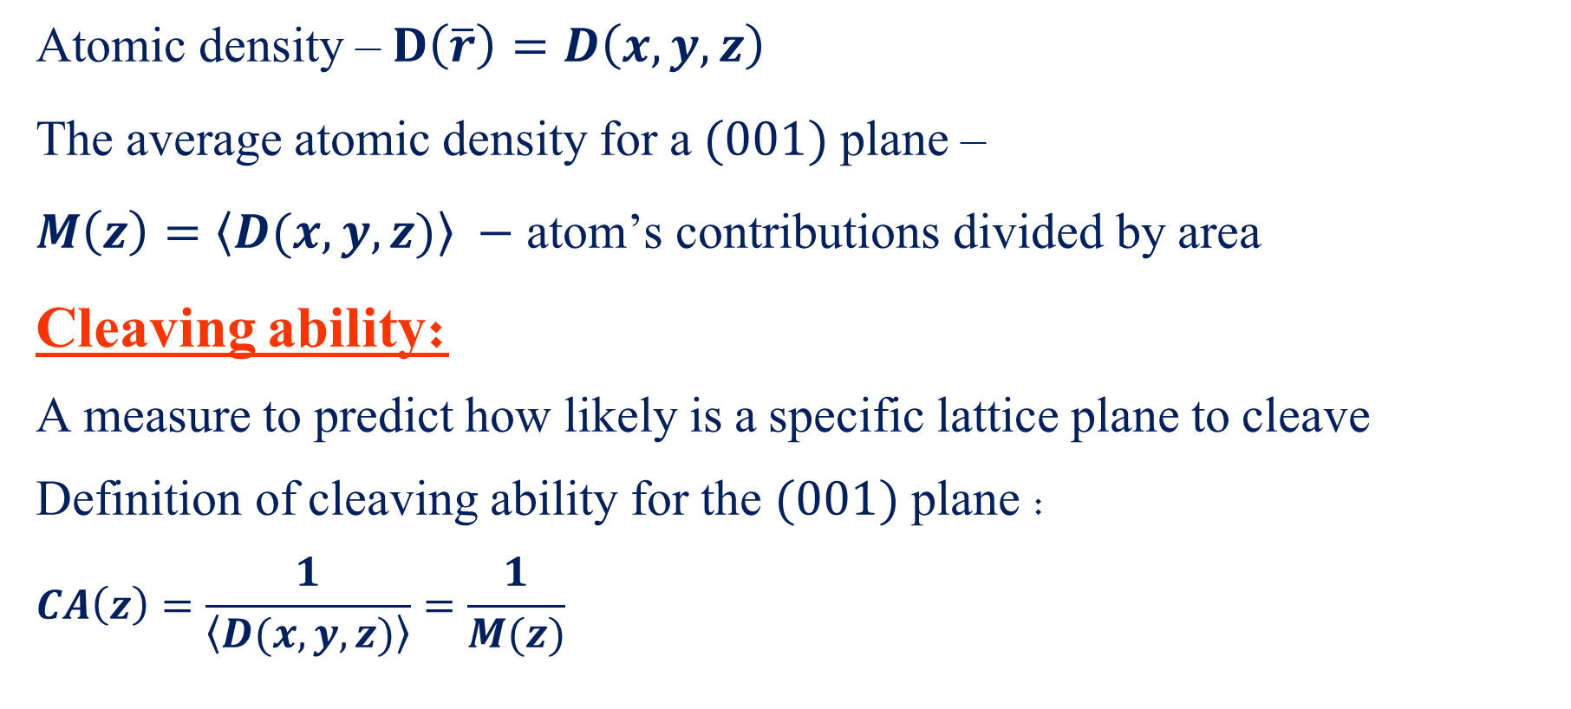
Average atomic density & Cleaving ability
Atomic density – $D\left(\overline{r}\right)=D\left(x,y,z\right)$
The average atomic density for a $(001)$ plane –
$M\left(z\right)=〈D(x,y,z)〉 −$ atom’s contributions divided by area
Cleaving ability:
A measure to predict how likely is a specific lattice plane to cleave
Definition of cleaving ability for the $(001)$ plane :
$$CA\left(z\right)=\frac{1}{〈D(x,y,z)〉}=\frac{1}{M(z)}$$
Notes:
So now we need to explain what is Average atomic density and what is Cleaving ability according to our definitions –
Assuming a given atomic density, denoted by D, the Average atomic Density for a (001) plane is given by the atom’s contributions divided by the relevant area. In the case of (001) plane, this area is parallel to (xy) plane.
Cleaving ability is maybe the most important parameter of this work, and it is a measure to predict how likely a lattice plane will tend to cleave. The cleaving ability is simply one over the average atomic density.

Slide 23
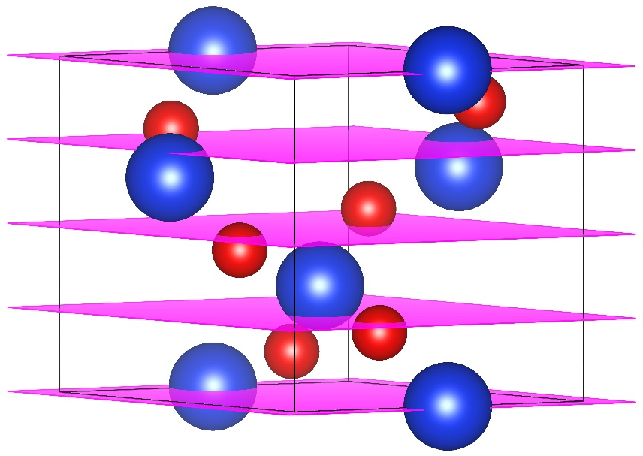
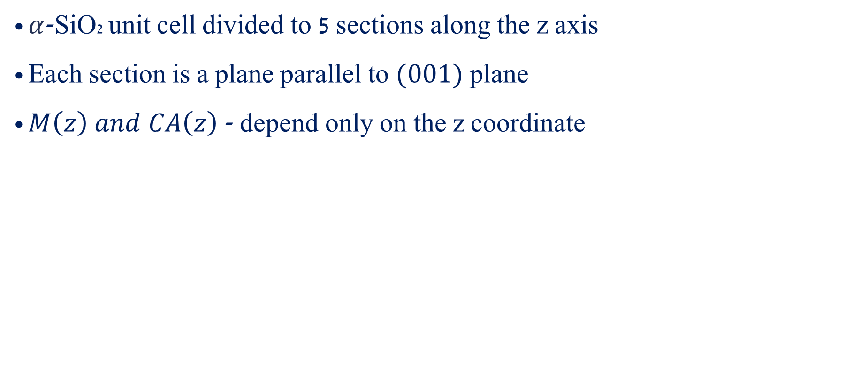
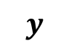
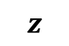
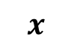
Average atomic density & Cleaving ability
$α$-SiO2 unit cell divided to 5 sections along the z axis
Each section is a plane parallel to $(001)$ plane
$M\left(z\right) and CA\left(z\right)$ - depend only on the z coordinate
5
4
3
$$z$$
2
$$y$$
1
$$x$$
Notes:
In order to simplify and visualize the terms - Average atomic density & Cleaving ability, we will use this ɑ-SiO₂ unit cell as an example, where atoms are represented geometrically as spheres. In this case the unit cell is divided to 5 sections (in general it was divided to N sections, usually 100). The area of the atoms intersecting these (001) planes (“the sections”) is calculated for each section, and divided by the area of the plane. This is in fact the Average atomic density, and as you can see this calculation is slightly different for each section. The Cleaving ability is simply one over the average atomic density, and we’re looking for the maximum cleaving ability (the section with the highest probability to enable cleavage).

Slide 24
Average atomic density & Cleaving ability
$α$-SiO2 unit cell divided to 5 sections along the z axis
Each section is a plane parallel to $(001)$ plane
$M\left(z\right) and CA\left(z\right)$ - depend only on the z coordinate
5
4
3
$$z$$
2
$$y$$
1
$$x$$
Notes:
In order to simplify and visualize the terms - Average atomic density & Cleaving ability, we will use this ɑ-SiO₂ unit cell as an example, where atoms are represented geometrically as spheres. In this case the unit cell is divided to 5 sections (in general it was divided to N sections, usually 100). The area of the atoms intersecting these (001) planes (“the sections”) is calculated for each section, and divided by the area of the plane. This is in fact the Average atomic density, and as you can see this calculation is slightly different for each section. The Cleaving ability is simply one over the average atomic density, and we’re looking for the maximum cleaving ability (the section with the highest probability to enable cleavage).

Slide 25
Average atomic density & Cleaving ability
$α$-SiO2 unit cell divided to 5 sections along the z axis
Each section is a plane parallel to $(001)$ plane
$M\left(z\right) and CA\left(z\right)$ - depend only on the z coordinate
5
4
3
$$z$$
2
$$y$$
1
$$x$$
Notes:
In order to simplify and visualize the terms - Average atomic density & Cleaving ability, we will use this ɑ-SiO₂ unit cell as an example, where atoms are represented geometrically as spheres. In this case the unit cell is divided to 5 sections (in general it was divided to N sections, usually 100). The area of the atoms intersecting these (001) planes (“the sections”) is calculated for each section, and divided by the area of the plane. This is in fact the Average atomic density, and as you can see this calculation is slightly different for each section. The Cleaving ability is simply one over the average atomic density, and we’re looking for the maximum cleaving ability (the section with the highest probability to enable cleavage).

Slide 26
Average atomic density & Cleaving ability
$α$-SiO2 unit cell divided to 5 sections along the z axis
Each section is a plane parallel to $(001)$ plane
$M\left(z\right) and CA\left(z\right)$ - depend only on the z coordinate
5
4
3
$$z$$
2
$$y$$
1
$$x$$
Notes:
In order to simplify and visualize the terms - Average atomic density & Cleaving ability, we will use this ɑ-SiO₂ unit cell as an example, where atoms are represented geometrically as spheres. In this case the unit cell is divided to 5 sections (in general it was divided to N sections, usually 100). The area of the atoms intersecting these (001) planes (“the sections”) is calculated for each section, and divided by the area of the plane. This is in fact the Average atomic density, and as you can see this calculation is slightly different for each section. The Cleaving ability is simply one over the average atomic density, and we’re looking for the maximum cleaving ability (the section with the highest probability to enable cleavage).

Slide 27
Average atomic density & Cleaving ability
$α$-SiO2 unit cell divided to 5 sections along the z axis
Each section is a plane parallel to $(001)$ plane
$M\left(z\right) and CA\left(z\right)$ - depend only on the z coordinate
5
4
3
$$z$$
2
$$y$$
1
$$x$$
Notes:
In order to simplify and visualize the terms - Average atomic density & Cleaving ability, we will use this ɑ-SiO₂ unit cell as an example, where atoms are represented geometrically as spheres. In this case the unit cell is divided to 5 sections (in general it was divided to N sections, usually 100). The area of the atoms intersecting these (001) planes (“the sections”) is calculated for each section, and divided by the area of the plane. This is in fact the Average atomic density, and as you can see this calculation is slightly different for each section. The Cleaving ability is simply one over the average atomic density, and we’re looking for the maximum cleaving ability (the section with the highest probability to enable cleavage).

Slide 28
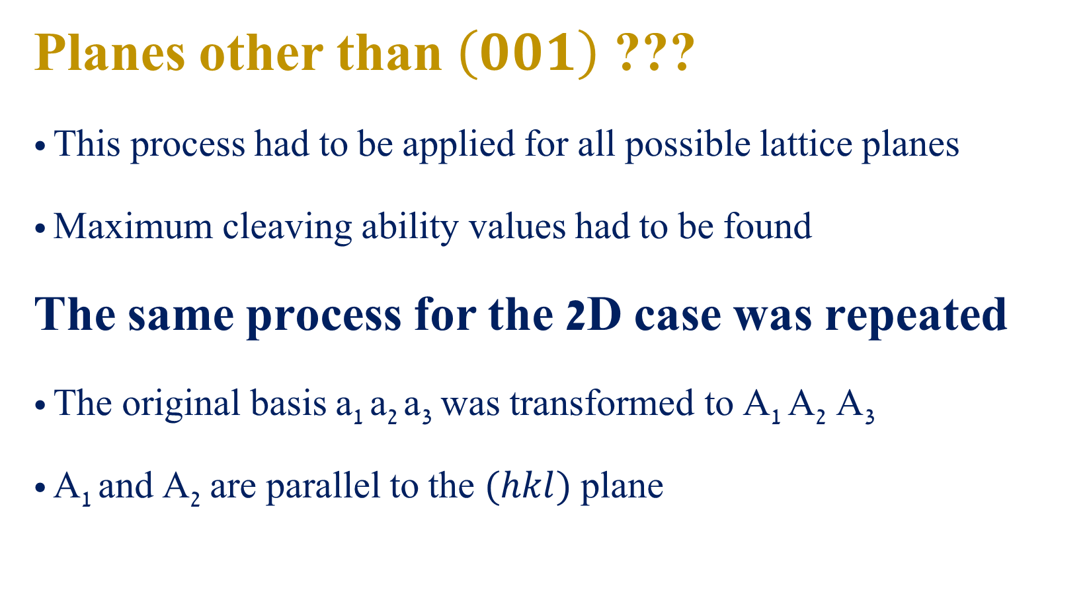
Planes other than $\left(001\right)$ ???
This process had to be applied for all possible lattice planes
Maximum cleaving ability values had to be found
The same process for the 2D case was repeated
The original basis a₁ a₂ a₃ was transformed to A₁ A₂ A₃
A₁ and A₂ are parallel to the $(hkl)$ plane
Notes:
What about planes other than (001) ?
Of course this process had to be repeated for all possible lattice planes (we control the number of planes), and maximum cleaving abilities had to be found. This time we are talking about the maximum cleaving ability from all planes.
How we did it?
The same process I showed you earlier for the 2D case was applied. Meaning, the original basis vectors a1 a2 a3 where transformed to capital A1 A2 A3, so that capital A1 A2 are parallel to the (hkl) plane.
In this way we made sure that the (hkl) plane in respect to the new basis vectors becomes (001).

Slide 29
Atomic density calculations
Probability Distribution Function (PDF):
Calculates the probability to find an atom within a certain volume in space
Atomic Displacement Parameters (ADPs):
Indicates magnitude and direction of thermal vibrations of atoms in crystals
Notes:
In the Quartz example I showed you how our model work treating atoms as solid spheres. In our model we used the Probability Distribution Function (PDF) which calculates the probability of finding an atom within a certain volume in space. Inside this function, the standard deviation derives from the Atomic Displacement Parameters (thermal ellipsoids).

Slide 30
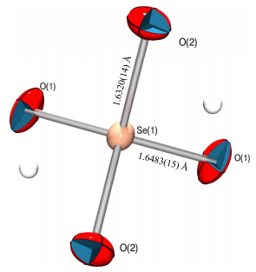
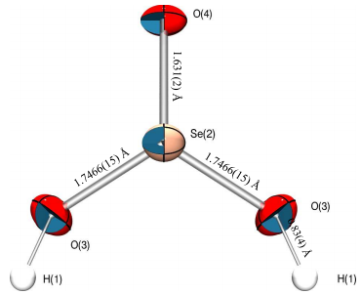
ORTEP – Oak Ridge Thermal Ellipsoid Plots
Program for drawing crystal structure illustrations
3. Hernández-Daguer, O. S., Barnes, C. L., Hernández-Rivera, S. P. & Ríos-Steiner, J. L. Crystal Structure Elucidation of the Novel Molecular-Inorganic Polymer K₂SeO₄· H₂SeO₃. ArXiv190103765 Cond-Mat (2019).
Notes:
Of course we didn’t invent anything new with this Thermal Ellipsoids representation, as you can see in these ORTEP figures. These plots describe a Novel Molecular-Inorganic Polymer, where atoms are represented by thermal ellipsoids. ** In most cases it’s acceptable to plot these Ellipsoids so that the probability to find an atom inside of them is 50%.

Slide 31
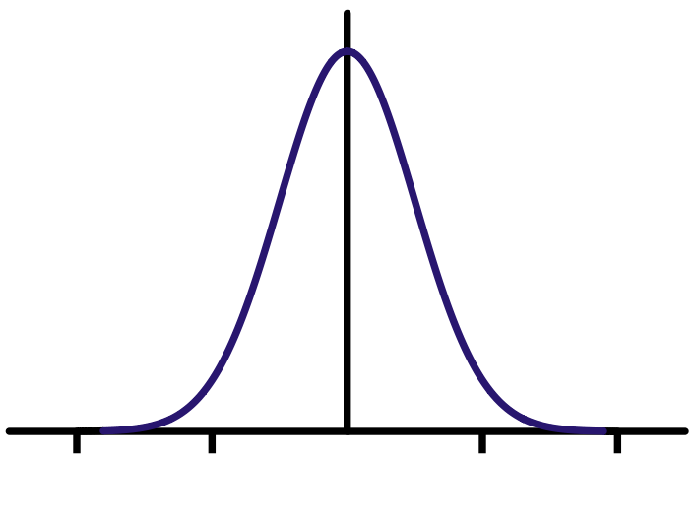











Atomic density calculations
$PDF=\frac{{\left|σ^{−1}\right|}^{1/2}}{{(2π)}^{3/2}}exp\left(−\frac{1}{2}u^{T}σ^{−1}u\right),$ $u=\left[\begin{matrix}x−x_{0} \\ y−y_{0} \\ z−z_{0}\end{matrix}\right]$
$σ$ – Standard information obtained from XRD, related to the ADPs
$$1D: f\left(x\right)=Nexp\left(−{\left(\frac{x−μ}{\sqrt{2}σ}\right)}^{2}\right)$$
$$2D: g\left(x,y\right)=Nexp\left(−{\left(\frac{x−μ_{x}}{{\sqrt{2}σ}_{x}}\right)}^{2}−{\left(\frac{y−μ_{y}}{{\sqrt{2}σ}_{y}}\right)}^{2}\right)$$
$f(x)$
$g(x,y)$
$y$
$x$
$x$
$x_{1}$
$x_{2}$
Notes:
Let’s go back to Atomic density calculations and explain what is this PDF function. In fact it’s a 3D Gaussian which includes a column vector u representing the atom position in respect to it’s average position (x0,y0,z0), and it also contains sigma, the standard deviation, which in this case that’s a standard information obtained from X-ray Diffraction experiment. This sigma is related to the ADPs.
In order to better understand this 3D Gaussian we can start with a 1D Gaussian, on the left. If we pass a horizontal line we will intersect it in two points of equal probability, x1 x2. In the 2D case, passing a horizontal plane intersecting this 2D Gaussian yields an ellipse of equal probability.

Slide 32





Atomic density calculations
$$3D: h\left(x,y,z\right)=Nexp\left(−{\left(\frac{x−μ_{x}}{{\sqrt{2}σ}_{x}}\right)}^{2}−{\left(\frac{y−μ_{y}}{{\sqrt{2}σ}_{y}}\right)}^{2}−{\left(\frac{z−μ_{z}}{{\sqrt{2}σ}_{z}}\right)}^{2}\right)$$
$$z$$
$x$
$y$
Notes:
And in the 3D case we can’t really plot this 3D Gaussian (it’s in the fourth dim), but intersecting it with a horizontal hyperplane yields an ellipsoid of equal probability. Each point on this ellipsoid has the same probability of finding the atom there. N is the normalizing factor, Miu and Sigma are the average position and standard deviation on each of the axes respectively.

Slide 33

Atomic density calculations
Notes:
We saw plots and equations but I remind you that this thesis work is in fact an algorithm that we wrote using Matlab. So this is just a small piece of our code, very relevant to this chapter. This function helped us calculating the Probability Distribution Function. The displacement coordinates are represented here by (xyz), A is a matrix related to the ADPs (Sigma…), and N is the normalization factor. This is exactly the equation we saw earlier.

Slide 34

Applying the process for 2D structure – Graphene
The atomic density $D\left(x,y\right)$ was calculated using the graphene CIF file
Average atomic density and cleaving ability were calculated for $\left(01\right)$ plane –
$M_{g}\left(y\right)=〈D_{g}(x,y)〉$
$CA_{g}(y)=\frac{1}{〈D_{g}(x,y)〉}=\frac{1}{M_{g}\left(y\right)}$
Notes:
Now I want to give an example of applying this process on a 2D structure – Graphene. We started by calculating the atomic density using Graphene CIF file. Then we could calculate the Average Atomic Density and Cleaving Ability, starting with the (01) plane, and these are the equations.

Slide 35


Into the Graphene network
Crystal system: Hexagonal
Planar space group: $p6mm$ (17)
Point group: $3m$
Lattice parameter: a = 2.46 Å
Unit cell: C[1/3,2/3] 2b
Atomic displacement parameters:
[0.0031,0.0031,0.0016]
4. Trucano, P. & Chen, R. Structure of graphite by neutron diffraction. Nature 258, 136–137 (1975).
Notes:
This is the relevant information from the graphene CIF file. In fact it was a CIF file of graphite, and we made a few adjustments to it. Using this information we built the unit cell, calculating the atomic density, and then the average atomic density and cleaving ability for each plane.

Slide 36







$$\left(01\right) planes$$
$$a_{2}$$
$$section:$$
$$a_{2}=0$$
$$a_{1}=0.5$$
$$a_{1}$$
Notes:
Let’s take a closer look on (01) plane – On the left we have an image of graphene network, and a unit cell with basis vectors a1 a2. On the right we have a plot of the Atomic Density vs the position along the a1 coordinate (which is the (01) plane). On section y=0, we start with a very low atomic density is, having no atoms there, it reaches a maximum where x=0.5 (in between these two atoms), and drops again to almost zero where x=1.

Slide 37




$$\left(01\right) planes$$
$$a_{2}$$
$$section:$$
$$a_{2}=1/3$$
$$a_{1}=2/3$$
$$a_{1}$$
Notes:
On section y=1/3, we start with a low atomic density is, we reach a maximum for x=2/3, then the atomic density drops again.

Slide 38


$$\left(01\right) planes$$
$$a_{2}$$
$$section:$$
$$a_{2}=0.5$$
$$a_{1}$$
Notes:
We can see the same concept for the section y=0.5 – as we get close to atoms, the atomic density increases, and when we move away from these atoms, the atomic density decreases.

Slide 39


$$\left(01\right) planes$$
$$a_{2}$$
$$section:$$
$$a_{2}=2/3$$
$$a_{1}$$
Notes:
The same with the y=2/3 section.

Slide 40





Scanning all possible planes – plotting CA vs lattice planes
$$\left(11\right) planes$$
$$a_{2}$$
$$\left(01\right) planes$$
$$a_{1}$$
Notes:
After scanning all possible planes and calculating Cleaving Ability for each of the planes we get the plot shown on the right. The highest cleaving ability was achieved for (10) planes, we can see it in green with its family members. Another high cleaving ability value was achieved for (11) planes, in yellow. The length of the peaks (from the center of the circle the edge) is proportional to the cleaving ability of the specific plane. For the (01) plane it looks pretty obvious why do we get high CA value, but what about the (11) plane?

Slide 41

Scanning all possible planes – plotting CA vs lattice planes
$$\left(11\right) planes$$
$$a_{2}$$
$$\left(01\right) planes$$
$$a_{1}$$
Notes:
So I will remind you that the CA is determined after scanning the unit cell for different sections, and here we see how this plane passing “in between” atoms, and this is why we also get high CA value.

Slide 42
Outline
Introduction
Aim of Work
Model
Results
Conclusions

Slide 43


Silicon structure
Structural information
Crystal system:
Cubic
Lattice parameters:
$$a_{1}=a_{2}=a_{3}=5.43Å$$
$$α_{1}=α_{2}=α_{3}={90}^{0}$$
Space group:
$Fd\overline{3}m$ (225)
Point group:
$$m\overline{3}m$$
Unit cell:
Si [0,0,0] 8a
ADPs:
$$U_{11} U_{22} U_{33} U_{23}U_{13}U_{12}$$
$$\left[0.007,0.007,0.007,0.0,0.0,0.0\right]$$
Position of atoms:
$\left[0,0,0\right],$ $\left[0.25,0.25,0.25\right]$
$$\left[0,0.5,0.5\right], \left[0.25,0.75,0.75\right]$$
$$\left[0.5,0,0.5\right], \left[0.75,0.25,0.75\right]$$
$$\left[0.5,0.5,0\right], \left[0.75,0.75,0.25\right]$$
5. Hom, T., Kiszenik, W. & Post, B. Accurate lattice constants from multiple reflection measurements. II. Lattice constants of germanium silicon, and diamond. J. Appl. Crystallogr. 8, 457–458 (1975).

Slide 44




$$Silicon srtucture$$
$\left(110\right)$ plane scan

Slide 45

$$Silicon srtucture$$
$\left(110\right)$ plane scan

Slide 46




$$Silicon srtucture$$
$\left(111\right)$ plane scan

Slide 47

$$Silicon srtucture$$
$\left(111\right)$ plane scan

Slide 48


Stereographic projection of reciprocal directions of silicon reciprocal lattice
Each point represents a reciprocal direction which is normal to a silicon lattice plane
Planes $(111)$ & $(110)$ are marked in the plot, both known as cleavage planes
$$Max CA\left(111\right)={55.77}_{[Å^{3}/e]}$$
$$Max CA\left(110\right)={8.99}_{[Å^{3}/e]}$$

Slide 49



$$LiNbO_{3} structure$$
Structural information
Crystal system:
Trigonal
Lattice parameters:
(hexagonal setting)
$$a_{1}=a_{2}=5.15Å a_{3}=13.86Å$$
$$α_{1}=α_{2}={90}^{0} α_{3}={120}^{0}$$
Space group: Point group:
$R3c$ (161) $3m$
Unit cell:
Li [0,0,0.28] 6a,
Nb [0,0,-0.001] 6a,
O [0.48,0.34,0.06] 18b
ADPs:
Li [0.01,0.01,0.02,0,0,0.006]
Nb [0.005,0.005,0.004,0,0,0.002]
O [0.007,0.006,0.007,-0.002,-0.001,0.003]
Position of atoms:
Li: [0,0,0.28], [0,0,0.78],
[0.33,0.67,0.45], [0.33,0.67,0.95],
[0.67,0.33,0.11], [0.67,0.33,0.61]
Nb:[0,0,0], [0.33,0.67,0.17],
[0,0,0.5], [0.33,0.67,0.67],
[0.67,0.33,0.33], [0.67,0.33,0.83]
O: [0.32,0.04,0.40], [0.66,0.70,0.06],
[0.99,0.37,0.73], [0.05,0.70,0.56],
[0.38,0.37,0.23], [0.71,0.04,0.90],
[0.30,0.95,0.06], [0.63,0.62,0.73],
[0.96,0.29,0.40], [0.32,0.29,0.90],
[0.66,0.95,0.56], [0.99,0.62,0.23],
[0.30,0.34,0.56], [0.63,0.01,0.23],
[0.96,0.68,0.90], [0.05,0.34,0.06],
[0.38,0.01,0.73], [0.71,0.68,0.40]
6. Hsu, R., Maslen, E. N., Du Boulay, D. & Ishizawa, N. Synchrotron X-ray studies of LiNbO3 and LiTaO3. Acta Crystallogr. B 53, 420–428 (1997).

Slide 50




$$LiNbO_{3} srtucture$$
$\left(012\right)$ plane scan

Slide 51

$$LiNbO_{3} srtucture$$
$\left(012\right)$ plane scan

Slide 52




$$LiNbO_{3} srtucture$$
$\left(116\right)$ plane scan

Slide 53

$$LiNbO_{3} srtucture$$
$\left(116\right)$ plane scan

Slide 54


Stereographic projection of reciprocal directions of lithium niobate reciprocal lattice
Planes$\left(100\right),\left(012\right),\left(116\right),\left(104\right)$and$\left(104\right)$ are marked in the plot
Planes$\left(100\right),\left(012\right)$ are known in literature
Plane$(116)$ was discovered in our model and confirmed experimentally
$$Max CA\left(012\right)={2.95}_{[Å^{3}/e]}$$
$$Max CA\left(104\right)={2.16}_{[Å^{3}/e]}$$
$$Max CA\left(100\right)={2.09}_{[Å^{3}/e]}$$
$$Max CA\left(110\right)={2.06}_{[Å^{3}/e]}$$
$$Max CA\left(116\right)={1.89}_{[Å^{3}/e]}$$

Slide 55



$$α−SiO_{2} structure$$
Structural information
Crystal system:
Trigonal
Lattice parameters:
(hexagonal setting)
$$a_{1}=a_{2}=4.91Å a_{3}=13.86Å$$
$$α_{1}=α_{2}={90}^{0} α_{3}={120}^{0}$$
Space group: Point group:
$P_{3}21$ (154) $3m$
Unit cell:
Si [0.47, 0, 0] 3a,
O [0.41, 0.27, 0.12] 6c
ADPs:
Si [0.0086, 0.0072, 0.0073, -0.00002, -0.00001, 0.0036]
O [0.0175, 0.0132, 0.0123, -0.0041, -0.0029, 0.0097]
Position of atoms:
O: [0.41,0.27,0.12],
[0.27,0.41,0.55],
[0.85,0.59,0.45],
[0.14,0.73,0.88],
[0.59,0.85,0.21],
[0.73,0.15,0.79]
Si:[0.53,0.53,0.33],
[0,0.47,0.67],
[0.47,0,0]
7. Levien, L., Prewitt, C. T. & Weidner, D. J. Structure and elastic properties of quartz at pressure. Am. Mineral. 65, 920–930 (1980).

Slide 56




$$α−SiO_{2} srtucture$$
$\left(011\right)$ plane scan

Slide 57

$$α−SiO_{2} srtucture$$
$\left(011\right)$ plane scan

Slide 58




$$α−SiO_{2} srtucture$$
$\left(110\right)$ plane scan

Slide 59

$$α−SiO_{2} srtucture$$
$\left(110\right)$ plane scan

Slide 60


Stereographic projection of reciprocal directions of quartz reciprocal lattice
Planes$(011),\left(101\right),\left(112\right),\left(010\right)$and$\left(110\right)$ are marked in the plot
Planes$\left(011\right),\left(010\right),\left(110\right),(111)$and$(001)$ are known in literature
Planes$\left(111\right) \& (001)$ are not marked
$$Max CA\left(011\right)={3.06}_{[Å^{3}/e]}$$
$$Max CA\left(101\right)={2.95}_{[Å^{3}/e]}$$
$$Max CA\left(112\right)={1.87}_{[Å^{3}/e]}$$
$$Max CA\left(010\right)={1.83}_{[Å^{3}/e]}$$
$$Max CA\left(110\right)={1.66}_{[Å^{3}/e]}$$

Slide 61



Cleavage ability Vs Cleavage energy
Silicon
Perfect prediction
Correct order
Lithium niobate
Good prediction
Wrong order
Quartz
Good prediction
Unclear order
8. Pérez, R. & Gumbsch, P. Directional Anisotropy in the Cleavage Fracture of Silicon. Phys. Rev. Lett. 84, 5347–5350 (2000).
2. Hirsh, Y., Gorfman, S. & Sherman, D. Cleavage and surface energies of LiNbO3. Acta Mater. 193, 338–349 (2020)
9. Iwasa, M. & Bradt, R. C. Cleavage of Natural and Synthetic Single Crystal Quartz. Mat. Res. Bull 22, 1241–1248 (1987).

Slide 62
Outline
Introduction
Aim of Work
Model
Results
Conclusions

Slide 63

Conclusions
Cleavage is strongly related to average atomic density
Cleaving ability can be thought of a “geometrical cleavage”
Our algorithm can predict cleavage in crystal structures
It was applied successfully on Si, Quartz and LiNbO3 crystal structures
Both known and unknown cleavage planes were found
For LiNbO3 $\left(116\right)$ was confirmed experimentally
Atomic bonds may improve the performance of the model

Slide 64
Acknowledgements
Dr. Semën Gorfman
Prof. Dov Sherman
Dr. Hyeokmin Choe
Dr. David Spirito
The department of Materials Science and Engineering

Slide 65


